Slide 1

Activity 5: Color Feature Extraction
Ron Michael V. Acda
2019-03839

Slide 2
Objectives
Extract the background from an image using grayscale thresholding.
Transform an image into normalized chromaticity coordinate (NCC) space.
Perform Gaussian parametric segmentation of colored images.
Perform non-parametric segmentation of colored images.
Identify the strengths and weaknesses of parametric and non-parametric segmentation in practical applications.

Slide 3
Objectives
Extract the background from an image using grayscale thresholding.
Transform an image into normalized chromaticity coordinate (NCC) space.
Perform Gaussian parametric segmentation of colored images.
Perform non-parametric segmentation of colored images.
Identify the strengths and weaknesses of parametric and non-parametric segmentation in practical applications.

Slide 4
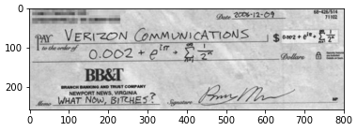
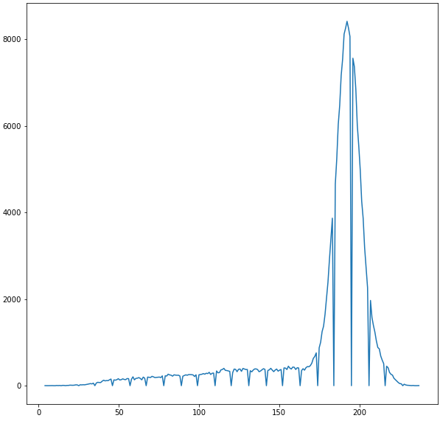
Background Removal
The background of an image can be removed by setting the grayscale threshold. The image is first loaded in grayscale and then clipped according to a threshold.
The grayscale histogram is used as a tool to identify the proper threshold. The background is usually located on the histogram peaks, so we clip them off.
Background pixels

Slide 5
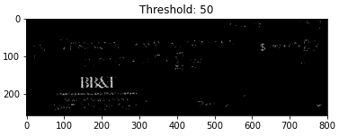
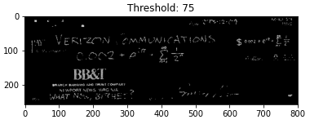
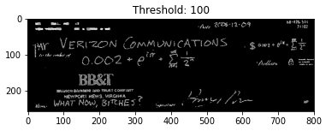
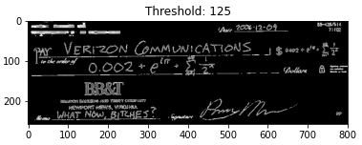
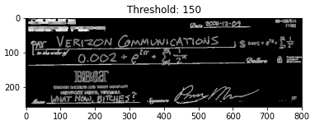
Background Removal
Based from the histogram previously, the background pixels must be somewhere between 175 and 225. Thus, a good threshold to clip the image is approximately within this range or close to it. Too low a threshold and too much is removed, and too high and too few background pixels will be removed.

Slide 6
Background Removal Code
file1 = '\cheque.png’ cheque = cv2.imread(path+file1,0) #load image in grayscale
thresholds = [50,75,100,125,150]
for t in thresholds: #set threshold grayscale intensity to remove background
cheque_tresholded = (cheque<t)*cheque
plt.figure()
plt.imshow(cheque_tresholded,cmap='gray')
plt.title('Threshold: {}'.format(t))

Slide 7
Objectives
Extract the background from an image using grayscale thresholding.
Transform an image into normalized chromaticity coordinate (NCC) space.
Perform Gaussian parametric segmentation of colored images.
Perform non-parametric segmentation of colored images.
Identify the strengths and weaknesses of parametric and non-parametric segmentation in practical applications.

Slide 8
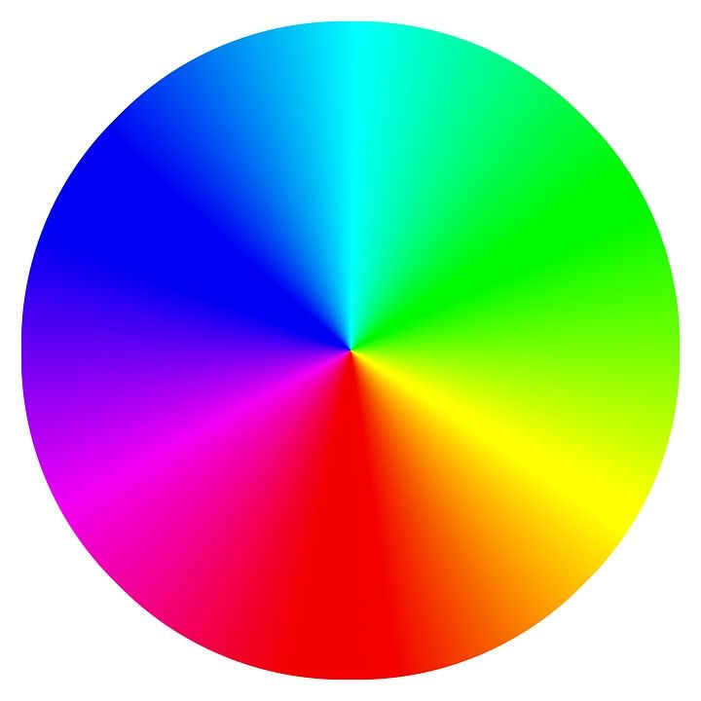
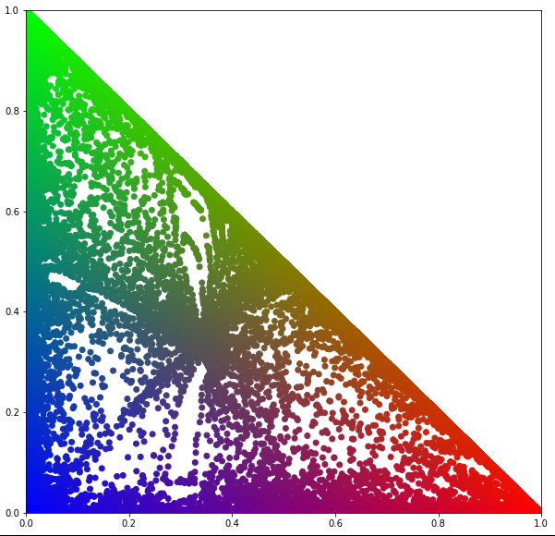
NCC Space
By dividing each of the RGB channels by the per-pixel intensity R+G+B, we obtain the normalized chromaticity coordinates. This is used to account for various shades and reflections of colors when performing color segmentation.
We plot the normalized reds in the x-axis and normalized greens in the y-axis. The NCC space of a color wheel is shown on the right.

Slide 9
NCC Space
Note that the spectrum of colors in the color wheel isn’t complete, as can be seen in the gaps in the NCC plot. There is a lack of whites and shades of green, red and blue.

Slide 10
NCC Space
#Convert to normalized chromaticity coordinates
def ncc(RGB):
r,g= (RGB[:,:,0]/np.sum(RGB,axis=2)), (RGB[:,:,1]/np.sum(RGB,axis=2))
b = 1-(r+g)
result = np.stack([r,g,b],axis=2)
result[result==0] = 100000000
return np.stack([r,g,b],axis=2) # Stack R, G, and B arrays along the third dimension

Slide 11
NCC Space
#Plots only the r and g channels in the NCC of the image.
def ncc_plotter(image, size=(10,10), color=True):
image_ncc = ncc(image)
r,g = image_ncc[:,:,0], image_ncc[:,:,1]
b=1-(r+g)
RGB_flat = image_ncc.reshape(-1,3)
plt.figure(figsize=size)
if color:
plt.scatter(r,g, c=RGB_flat)
else:
plt.scatter(r,g, c='k')
plt.xlim([0,1])
plt.ylim([0,1])

Slide 12
Objectives
Extract the background from an image using grayscale thresholding.
Transform an image into normalized chromaticity coordinate (NCC) space.
Perform Gaussian parametric segmentation of colored images.
Perform non-parametric segmentation of colored images.
Compare runtimes of brute-force (nested for loop) pixel-by-pixel lookup vs vectorized lookup algorithm.
Identify the strengths and weaknesses of parametric and non-parametric segmentation in practical applications by testing the algorithms on a color wheel.

Slide 13
Parametric segmentation
To segment an image, we obtain the mean and standard deviations of the r and g channels (in NCC space) of the ROI. Each pixel in the original image is then assigned a value based on how likely it is to be part of the ROI i.e., the “farther” the r and g values of that pixel to the mean of the r and g in the ROI, the less likely it is to be part of the ROI. This likelihood is measured by the Gaussian distribution.
Therefore, this can be thought of as a probabilistic/statistical segmentation.

Slide 14
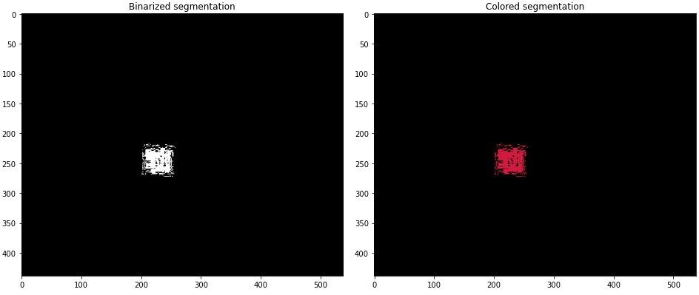
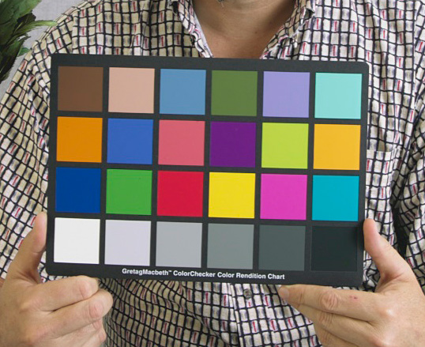
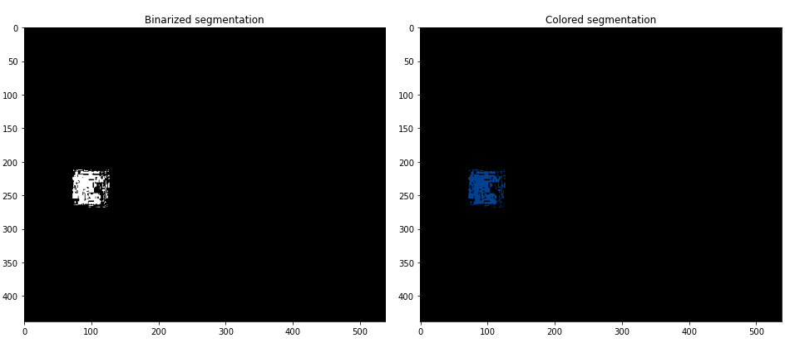
Parametric Segmentation

Slide 15
Parametric Segmentation
Note the granularity in the segmentation. In fact, as the size or number of pixels in the ROI increases, the granularity in segmentation is reduced (as I will explain in later slides).
Spoiler alert: Parametric segmentation is based on statistical segmentation; a greater sample size (i.e., a higher number of pixels in the ROI) will mean a more robust segmentation.

Slide 16
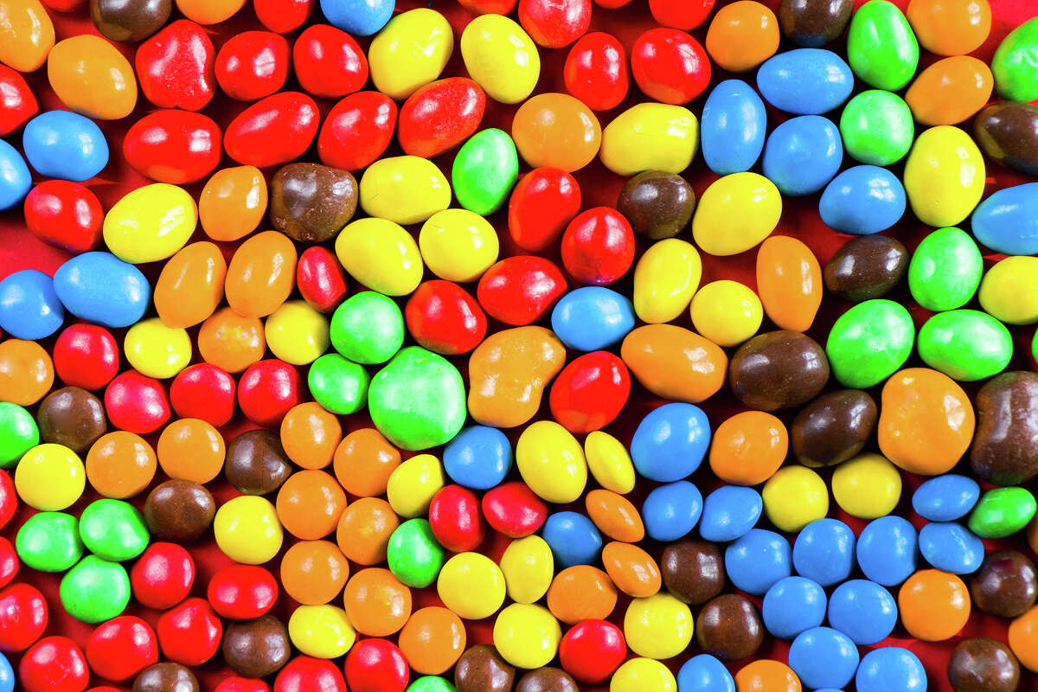
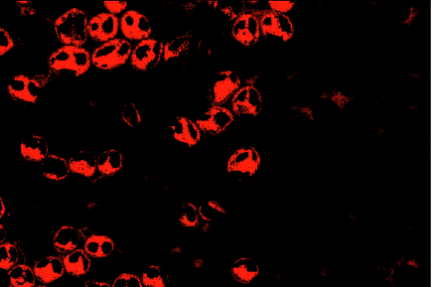
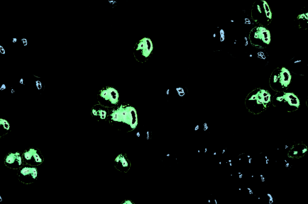
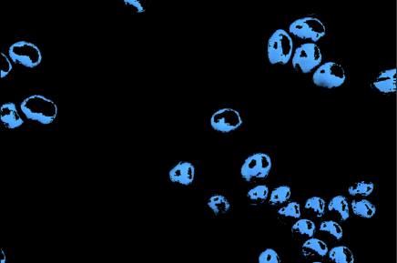
Parametric Segmentation
Reds
Greens
Blues

Slide 17
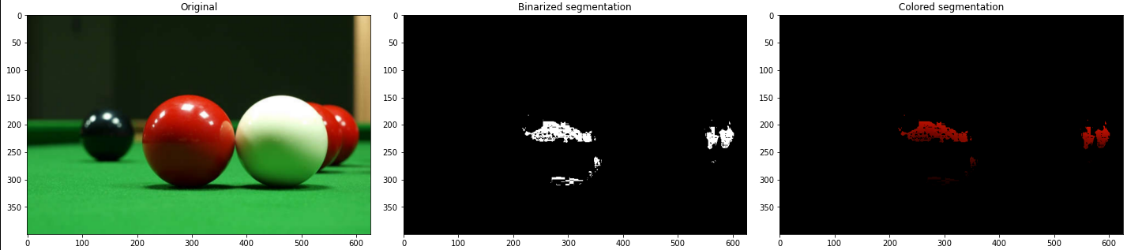
Parametric Segmentation
By itself, the output P of a Gaussian parametric segmentation is probabilistic i.e., a range of values from 0 to 1. This begs the question: how do we binarize the segmentation so we can restore the color from the segmented image?
Answer: Use skimage.filters.threshold_otsu(P[np.isfinite(P)]
This is the Python equivalent of Matlab’s imbinarize().

Slide 18
Parametric Segmentation
def gaussian(mu,sigma, x): #Compute probability of a certain value or pixel
mu,sigma,x= np.array(mu), np.array(sigma), np.array(x)
if sigma == 0:
a = np.zeros_like(x)
b=a
else:
a = (1/(sigma*np.sqrt(2*np.pi)))
b = np.exp(-(x-mu)**2/(2*sigma**2))
return a*b

Slide 19
Parametric Segmentation
def gaussian_segmenter(image, binarized=True):
ROI_image = ROI(image)
ROI_ncc = ncc(ROI_image)
image_ncc = ncc(image)
r_mean, g_mean = np.mean(ROI_ncc[:,:,0]), np.mean(ROI_ncc[:,:,1])
r_std, g_std = np.std(ROI_ncc[:,:,0]), np.std(ROI_ncc[:,:,1])
P = gaussian(r_mean, r_std,image_ncc[:,:,0])*gaussian(g_mean, g_std, image_ncc[:,:,1])
if binarized:
threshold_value = filters.threshold_otsu(P[np.isfinite(P)]) #handle only finite values, remove NaNs
P = P > threshold_value
return P
def colored_gaussian_segmenter(image):
P = gaussian_segmenter(image,binarized=True)
segmented_image = np.stack([P*image[:,:,0], P*image[:,:,1], P*image[:,:,2]], axis=2)
return segmented_image

Slide 20
Objectives
Extract the background from an image using grayscale thresholding.
Transform an image into normalized chromaticity coordinate (NCC) space.
Perform Gaussian parametric segmentation of colored images.
Perform non-parametric segmentation of colored images.
Compare runtimes of brute-force (nested for loop) pixel-by-pixel lookup vs vectorized lookup algorithm.
Identify the strengths and weaknesses of parametric and non-parametric segmentation in practical applications.

Slide 21
Non-parametric segmentation
Non-parametric segmentation does not require the fitting of a Gaussian or the calculation of the the mean and standard deviation of the r and g channels of the ROI.
Here are the general steps in performing non-parametric segmentation.
1. Create a 2D histogram of the ROI in NCC (r in y axis, g in x axis).
2. Per pixel of the image, obtain the r and g in NCC space.
3. Obtain the histogram count of the corresponding (r,g)
4. Assign a grayscale value equal to that count. of the ROI in NCC (r in y axis, g in x axis).

Slide 22
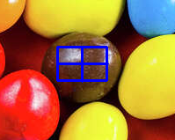
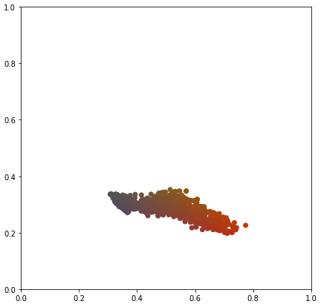
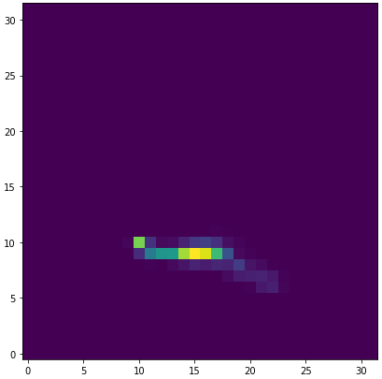
2D Histogram
The indices of a 2D histogram array are the r and g (NCC) bins. The value at each point corresponds to a pixel count in the ROI.
It should look similar to the NCC space plot of the ROI. From the 2D histogram, we can see which pixels (in NCC) are abundant in the ROI.
From the results, it can be seen that the 2D histogram indeed looks like the NCC plot of the ROI.

Slide 23
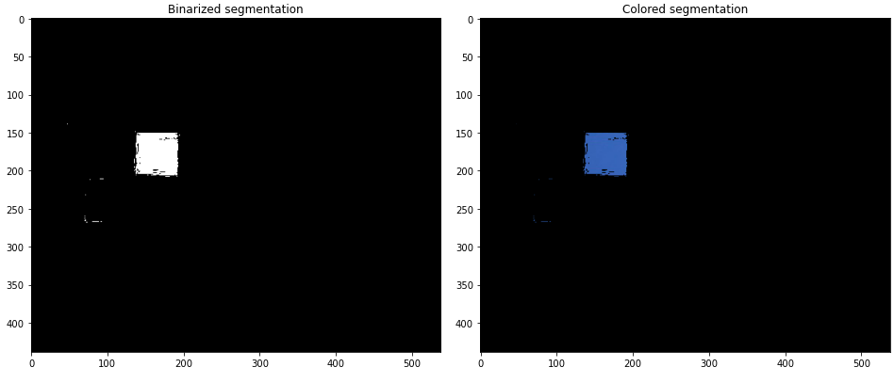
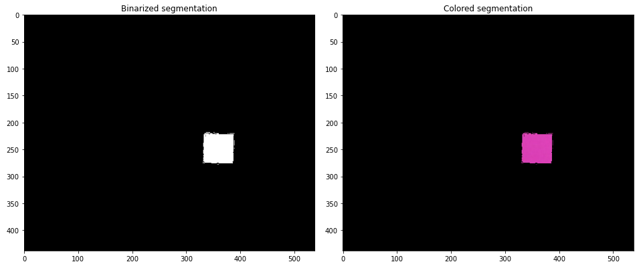
Non-parametric Segmentation

Slide 24
Non-parametric Segmentation
Here, we use a bin size of 32.
We will see later that non-parametric segmentation often resolves solid colors better than parametric segmentation especially when the ROI pixel count is low.
There is less granularity in the segmented images when using non-parametric segmentation.

Slide 25
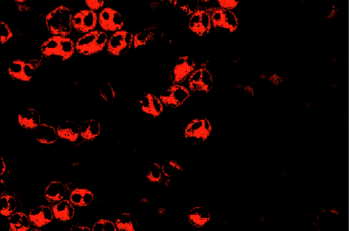
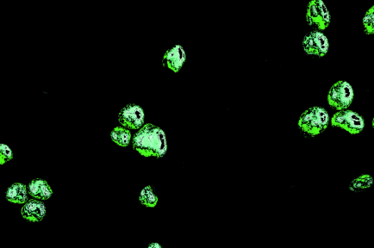
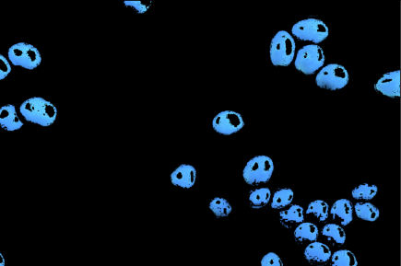
Non-parametric Segmentation

Slide 26
Objectives
Extract the background from an image using grayscale thresholding.
Transform an image into normalized chromaticity coordinate (NCC) space.
Perform Gaussian parametric segmentation of colored images.
Perform non-parametric segmentation of colored images.
Compare runtimes of brute-force (nested for loop) pixel-by-pixel lookup vs vectorized lookup algorithm.
Identify the strengths and weaknesses of parametric and non-parametric segmentation in practical applications.

Slide 27
Non-parametric Segmentation Algorithms
One way to implement the lookup search is by brute-force (pixel-by-pixel) assignment of values (as done in the module). This means using a nested for loop.
bins=32
x, y= ROI_ncc[:,:,0].flatten(), ROI_ncc[:,:,1].flatten()
H = np.histogram2d(y,x, bins=bins, range=[[0,1],[0,1]])
M,N = np.shape(image_ncc[:,:,0])
P = np.zeros_like(image_ncc[:,:,0])
for i in range(M):
for j in range(N):
i_index = int(image_ncc[i,j,0]*(bins-1) + 1)
j_index = int(image_ncc[i,j,1]*(bins-1) + 1)
if i_index == bins:
i_index = bins-1
if j_index == bins:
j_index = bins-1
P[i_index, j_index] = H[0][i_index, j_index]
if binarized:
threshold_value = filters.threshold_otsu(P[np.isfinite(P)]) #handle only finite values, remove NaNs
P = P > threshold_value

Slide 28
Non-parametric Segmentation Algorithms
However, this can be made more efficient. We use a cleaner, vectorized implementation using numpy.digitize() to automate the bin lookup.
bins=32
x, y= ROI_ncc[:,:,0].flatten(), ROI_ncc[:,:,1].flatten()
H = np.histogram2d(y,x, bins=bins, range=[[0,1],[0,1]])
M,N = np.shape(image_ncc[:,:,0])
P = np.zeros_like(image_ncc[:,:,0])
#Vectorized look-up algorithm based on 2D histogram
x_indices = np.digitize(image_ncc[:,:,0], H[1]) - 1
y_indices = np.digitize(image_ncc[:,:,1], H[2]) - 1
# Prevent possible IndexErrors by clipping the values to the valid index ranges.
x_indices = np.clip(x_indices, 0, bins-1)
y_indices = np.clip(y_indices, 0, bins-1)
P = H[0][y_indices, x_indices]
if binarized:
threshold_value = filters.threshold_otsu(P[np.isfinite(P)]) #handle only finite values, remove NaNs
P = P > threshold_value

Slide 29
Runtime Comparisons
Test 1: Billiard image (image size: 626x400, ROI size: 50x50, bin size = 32)
Runtime using nested for loops: 2.323850631713867 s
Runtime using vectorized look-up: 0.02889847755432129 s
Test 2: M&Ms (image size: 1200x800, ROI size: 50x50, bin size = 32).
Runtime using nested for loops: 3.07297945022583 s
Runtime using vectorized look-up: 0.1066887378692627 s
Test 3: Billiard image (image size: 626x400, ROI size: 100x100, bin size = 32)
Runtime using nested for loops: 2.23114275932312 s
Runtime using vectorized look-up: 0.02847456932067871 s
Test 4: Billiard image (image size: 626x400, ROI size: 50x50, bin size = 64)
Runtime using nested for loops: 2.275197744369507 s
Runtime using vectorized look-up: 0.027926921844482422 s
Conclusion: The vectorized implementation is faster than the brute-force implementation regardless of image size, ROI size and bin size by roughly two orders of magnitude. This shouldn’t be surprising.

Slide 30
Function implementation
def nonparametric_segmenter(image, ROI_image, bins=32, binarized=True):
image_ncc, ROI_ncc = ncc(image), ncc(ROI_image)
#2D histogram of ROI
x, y= ROI_ncc[:,:,0].flatten(), ROI_ncc[:,:,1].flatten()
H = np.histogram2d(y,x, bins=bins, range=[[0,1],[0,1]])
#Vectorized look-up algorithm based on 2D histogram
x_indices = np.digitize(image_ncc[:,:,0], H[1]) - 1
y_indices = np.digitize(image_ncc[:,:,1], H[2]) - 1
# Prevent possible IndexErrors by clipping the values to the valid index ranges.
x_indices = np.clip(x_indices, 0, bins-1)
y_indices = np.clip(y_indices, 0, bins-1)
P = H[0][y_indices, x_indices]
if binarized:
threshold_value = filters.threshold_otsu(P[np.isfinite(P)]) #handle only finite values, remove NaNs
P = P > threshold_value
return P

Slide 31
Objectives
Extract the background from an image using grayscale thresholding.
Transform an image into normalized chromaticity coordinate (NCC) space.
Perform Gaussian parametric segmentation of colored images.
Perform non-parametric segmentation of colored images.
Compare runtimes of brute-force (nested for loop) pixel-by-pixel lookup vs vectorized lookup algorithm.
Identify the strengths and weaknesses of parametric and non-parametric segmentation in practical applications.

Slide 32
Comparison using the Color Wheel
We test both segmentation methods based on their capabilities to discern color/hue, saturation, and discern color gradients (analogous colors).
We also test the effect of ROI size for both methods.
For non-parametric segmentation, we investigate the effect of increasing bin size.

Slide 33
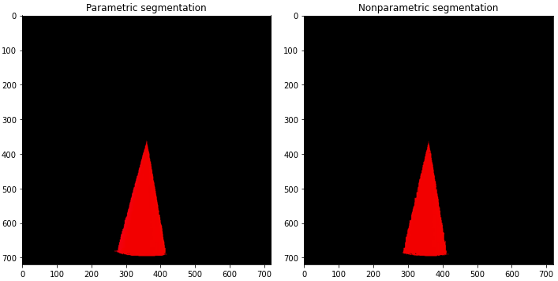
Comparison 1: RGB Discernment

Slide 34
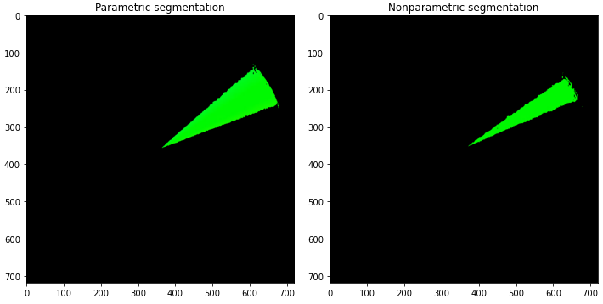
Comparison 1: RGB Discernment

Slide 35
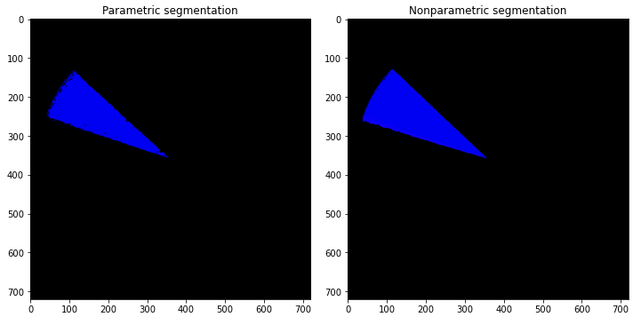
Comparison 1: RGB Discernment

Slide 36
Comparison 1: RGB Discernment
Under constant ROI (100x100) and a bin size of 32 for the non-parametric algorithm, both methods are able to discern RGB almost to the same degree.
Interestingly, slightly more greens were segmented by the parametric algorithm compared to the non-parametric algorithm.

Slide 37
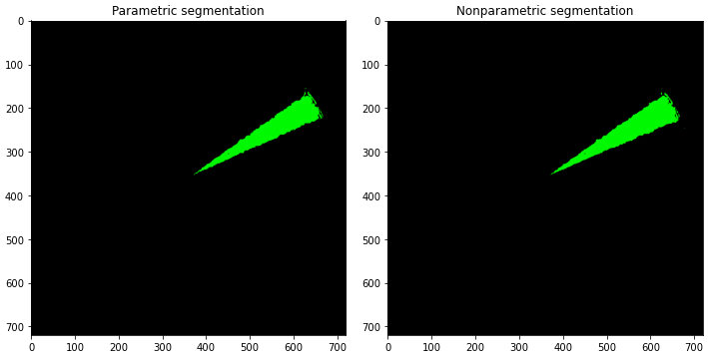
Comparison 2: ROI Size (50x50)

Slide 38
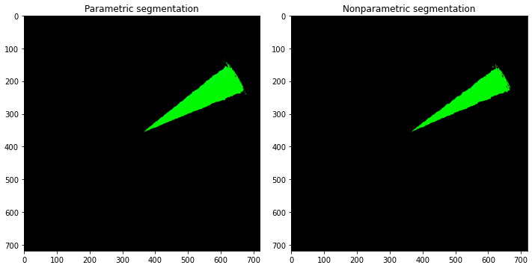
Comparison 2: ROI Size (80x80)

Slide 39
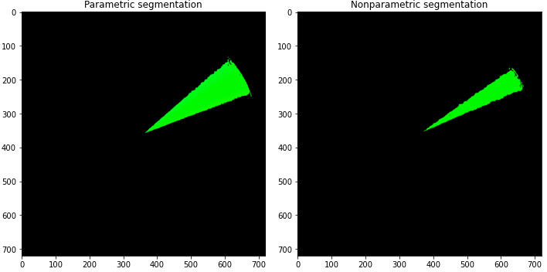
Comparison 2: ROI Size (80x80)

Slide 40
Comparison 2: ROI Size
As the ROI pixel count increases, the parametric segmentation algorithm becomes more robust and accurate, as shown by the increase in the angular width of the green hue. Parametric segmentation works best with larger ROI sizes due to its statistical nature (think of the sample size as the pixel count of the ROI).

Slide 41
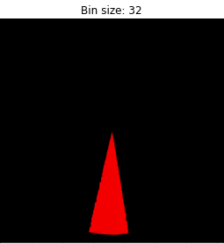
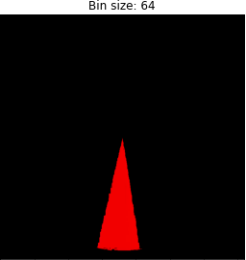
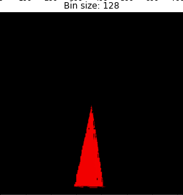
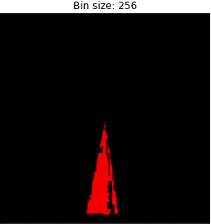
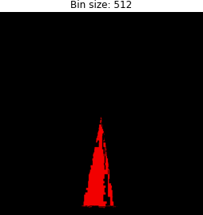
Comparison 3: Bin Size (Non-parametric)

Slide 42
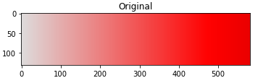
Comparison 3: Bin Counts and Saturation Range (Non-parametric)
ROI_images=[image[50:100, 75:125], image[50:100, 275:325], image[50:100, 475:525]]

Slide 43
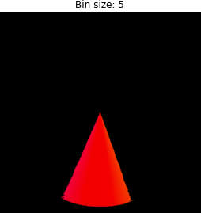
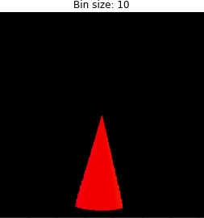
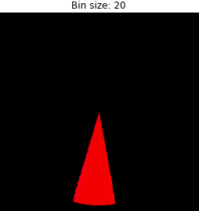
Comparison 3: Bin Size (Non-parametric)
As the number of bins increases, the segmentation algorithm becomes more “selective” i.e., the bin widths become smaller, so pixel membership becomes increasingly harder. This is why the segmented image appears more granulated.
However, if the bin size is too low, it might be easier for noise or unwanted pixels to “become members” of the ROI. Granted, such choice may be better if the ROI is a solid, uniform color.

Slide 44
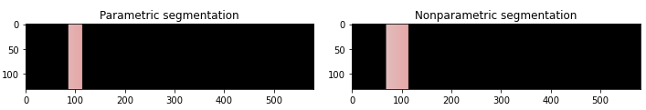
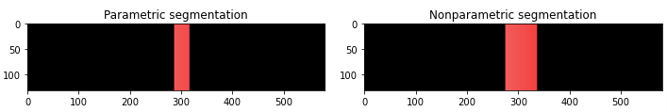
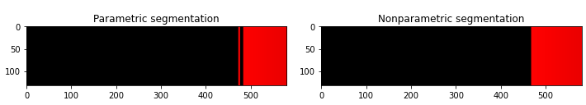
Comparison 4: Saturation Range
ROI_images=[image[50:100, 75:125], image[50:100, 275:325], image[50:100, 475:525]]
Strips of sizes 50x50 were selected across the range of red saturations. Bin counts is 32.
For this particular image, non-parametric segmentation is slightly less selective than parametric segmentation.

Slide 45
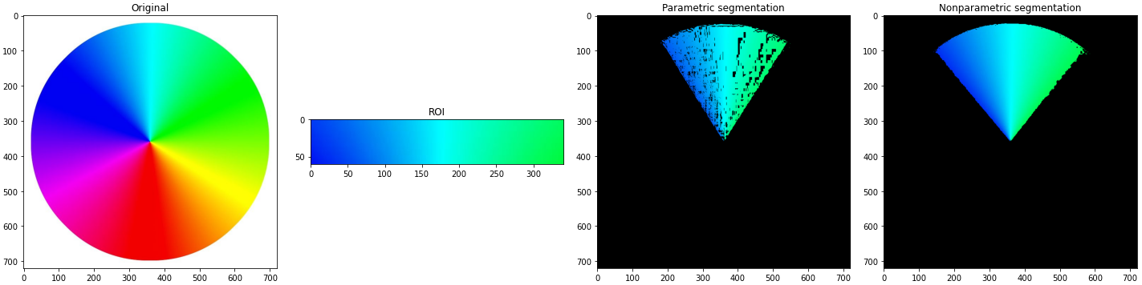
Comparison 5: Color Gradient
For color gradients, the non-parametric algorithm fares much better than the parametric algorithm.
Possible reasons: A color gradient means a higher standard deviation or spread in the color distribution, which means the uncertainty in the determination of pixel membership is higher.

Slide 46
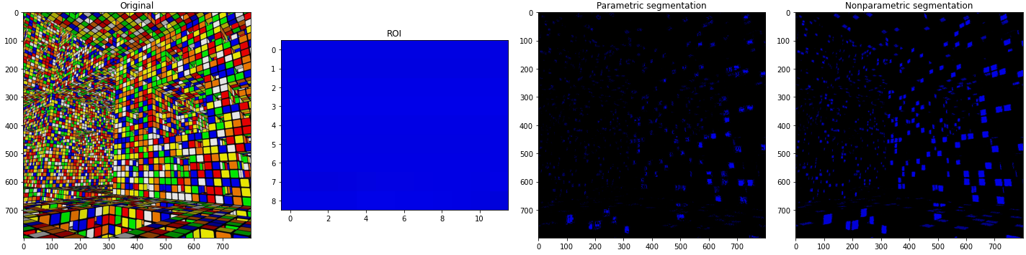
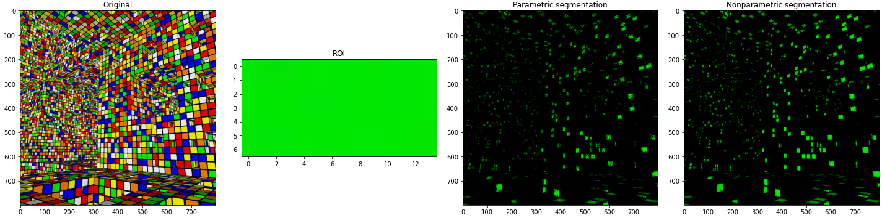
Comparison 6: Resolving Power

Slide 47
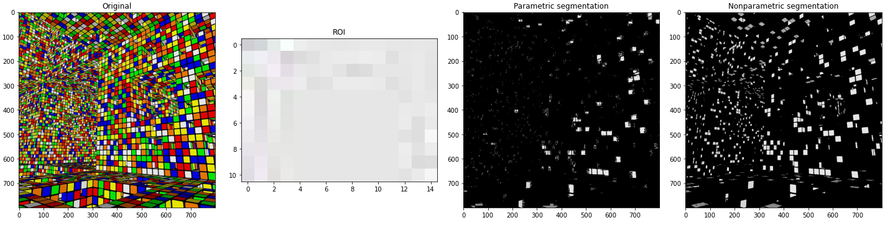
Comparison 6: Resolving Power
Parametric segmentation is less susceptible to noise, but this comes at the cost of potentially segmenting small, colored regions. They also work better at larger ROI sizes. Non-parametric segmentation is often better when segmenting colored images especially when the ROI is not that large.

Slide 48
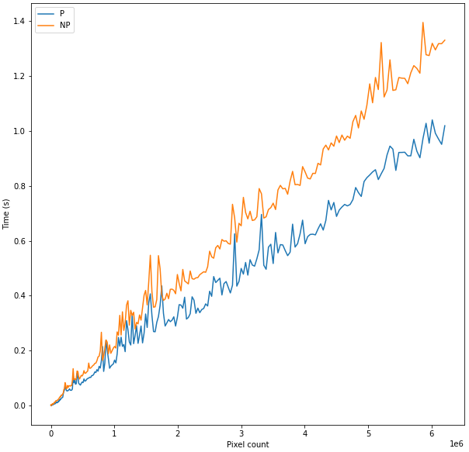
Comparison 7: Runtime/Time Complexity
Note: Both implementations are vectorized.
Here, we can see that both algorithms have linear time complexity. However, the parametric algorithm is generally faster than the non-parametric algorithm.

Slide 49
Comparison 7: Runtime/Time Complexity
#Test for a square, randomly-generated RGB image array.
sizes = np.array([10*i+2 for i in range(250)])
times_parametric= []
times_nonparametric = []
for N in sizes:
image = np.random.random_integers(0,255, size=(N,N,3))
ROI_image = image[1:51, 1:51]
start = time.time()
gaussian_segmenter(image, ROI_image)
end1 = time.time()
nonparametric_segmenter(image, ROI_image)
end2 = time.time()
times_parametric.append(end1-start)
times_nonparametric.append(end2-end1)
plt.figure(figsize=(10,10))
plt.plot(sizes**2, times_parametric, label='P')
plt.plot(sizes**2, times_nonparametric, label='NP')
plt.legend(loc='best')
plt.xlabel('Pixel count')
plt.ylabel('Time (s)')

Slide 50
Summary of Comparisons
Parametric segmentation is faster but requires a higher pixel count for the ROI to be robust and less granular because of its statistical nature. It is less susceptible to noise, especially at higher ROI pixel counts, but this makes them a bit more restrictive.
Non-parametric segmentation is a little bit slower but works quite well even for small ROI, especially solid/uniform colors. Despite its name, it actually requires the bin size as an input. Increasing the bin size makes them more selective at the risk of becoming more granular.

Slide 51
Self-Reflection
I took my time writing code and experimenting with the strengths and limitations of both algorithms using the color wheel and other pictures. I think I was able to explain and demonstrate their pros and cons quite well.
I made a vectorized implementation of both algorithms and avoided the use of for loops which bottleneck the speed of the code. I also compared the non-vectorized implementation in the module and a more efficient vectorized implementation and argued that the latter is roughly two orders of magnitude faster.
I compared the time complexities of both algorithms. This demands that both implementations are vectorized, otherwise, the time plot will take a **very** long time to create.
Self-score: 110/100

Slide 52
Sources
https://scipy-lectures.org/packages/scikit-image/auto_examples/plot_threshold.html (Otsu thresholding for image binarization)
Billiard balls, cheque, and Macbeth Color checker from AP157 Module, Automated Feature Extraction Part I
Color wheel: https://pixabay.com/illustrations/colour-wheel-spectrum-rainbow-1740381/
M&Ms candies: https://www.sfgate.com/politics/article/wokeness-m-and-ms-defeated-17736299.php
Rubiks’ cube room: https://www.pinterest.ph/pin/260716265899920795/

